Slide 1

Contraceptive Pills and Mortality
Bellevue University
DSC530
LaChandra Ash
February 24, 2020

Slide 2
Introduction
The Study: Royal College of General Practitioners’ Oral Contraception RCGP study started in 1968.
Data Supplied: The data for the study was supplied by the practitioners whom participated in the study, and the National Health Service central services.
Amount: There were 1,200 general practices within the United Kingdom.
Subjects: There were 46, 112 women whom underwent the 39 years in the study.
Results: There were 1,747 women that died and never took the pills. There were 2,864 whom used the pills and died.
The objective of the project is to view the risk of mortality among women whom consume oral contraceptives, versus women who never used them.

Slide 3

Hypothesis
What was the association of women whom died and were taking the pills.?
Were the woman whom consumed the contraceptive pills already at risk of dying before taking the pill?
What are other factors that may have caused death while the women took the pills?

Slide 4
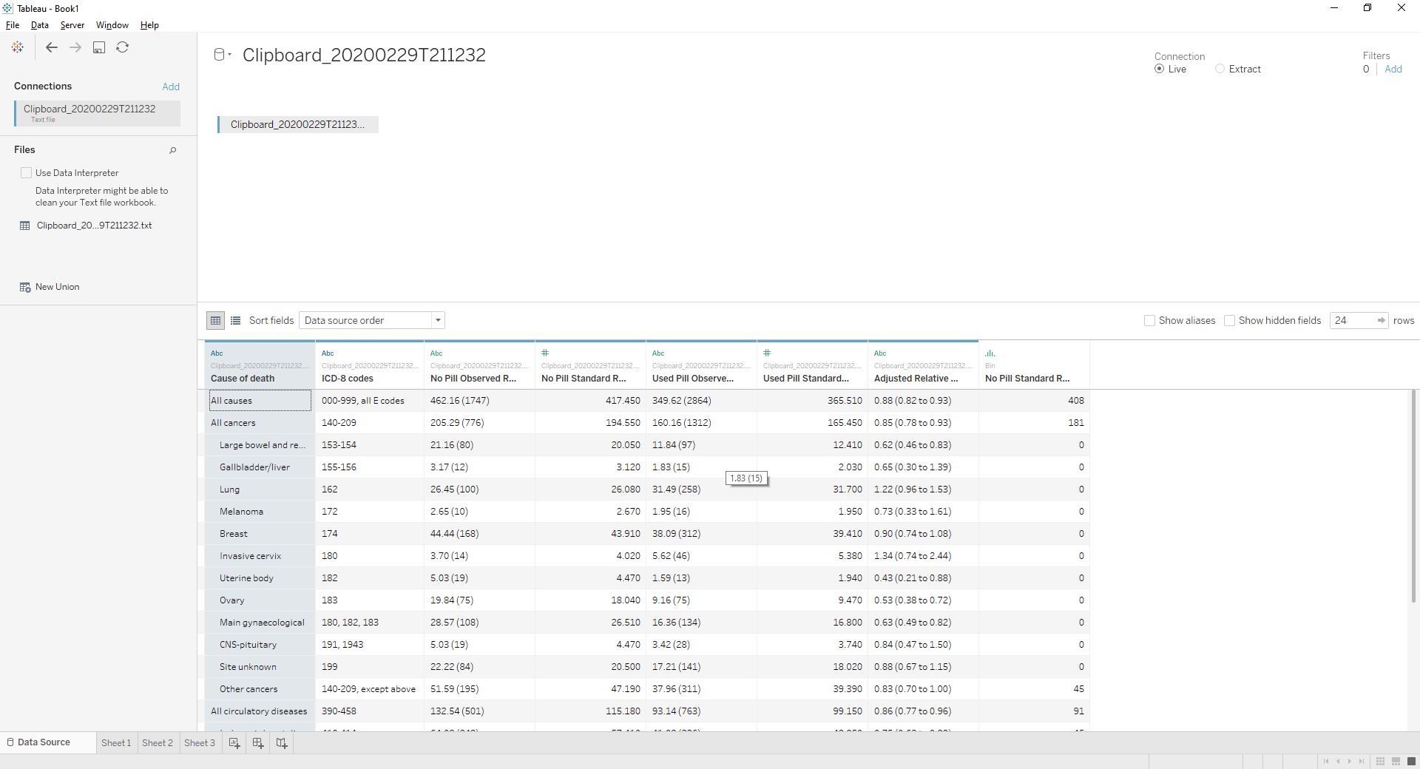
Dataset 2: Raw vs Clean
Cause of death | ICD-8 codes | Never users |  |  | Ever users |  | Adjusted relative risk† (95% CI)
 |  | Observed rate (No) | Standardised rate* |  | Observed rate (No) | Standardised rate*
All causes | 000-999, all E codes | 462.16 (1747) | 417.45 |  | 349.62 (2864) | 365.51 | 0.88 (0.82 to 0.93)
All cancers | 140-209 | 205.29 (776) | 194.55 |  | 160.16 (1312) | 165.45 | 0.85 (0.78 to 0.93)
Large bowel and rectum | 153-154 | 21.16 (80) | 20.05 |  | 11.84 (97) | 12.41 | 0.62 (0.46 to 0.83)
Gallbladder/liver | 155-156 | 3.17 (12) | 3.12 |  | 1.83 (15) | 2.03 | 0.65 (0.30 to 1.39)
Lung | 162 | 26.45 (100) | 26.08 |  | 31.49 (258) | 31.70 | 1.22 (0.96 to 1.53)
Melanoma | 172 | 2.65 (10) | 2.67 |  | 1.95 (16) | 1.95 | 0.73 (0.33 to 1.61)
Breast | 174 | 44.44 (168) | 43.91 |  | 38.09 (312) | 39.41 | 0.90 (0.74 to 1.08)
Invasive cervix | 180 | 3.70 (14) | 4.02 |  | 5.62 (46) | 5.38 | 1.34 (0.74 to 2.44)
Uterine body | 182 | 5.03 (19) | 4.47 |  | 1.59 (13) | 1.94 | 0.43 (0.21 to 0.88)
Ovary | 183 | 19.84 (75) | 18.04 |  | 9.16 (75) | 9.47 | 0.53 (0.38 to 0.72)
Main gynaecological | 180, 182, 183 | 28.57 (108) | 26.51 |  | 16.36 (134) | 16.80 | 0.63 (0.49 to 0.82)
CNS-pituitary | 191, 1943 | 5.03 (19) | 4.47 |  | 3.42 (28) | 3.74 | 0.84 (0.47 to 1.50)
Site unknown | 199 | 22.22 (84) | 20.50 |  | 17.21 (141) | 18.02 | 0.88 (0.67 to 1.15)
Other cancers | 140-209, except above | 51.59 (195) | 47.19 |  | 37.96 (311) | 39.39 | 0.83 (0.70 to 1.00)
All circulatory diseases | 390-458 | 132.54 (501) | 115.18 |  | 93.14 (763) | 99.15 | 0.86 (0.77 to 0.96)
Ischaemic heart disease | 410-414 | 64.02 (242) | 57.41 |  | 41.02 (336) | 42.85 | 0.75 (0.63 to 0.88)
Other heart | 420-429 | 15.34 (58) | 11.90 |  | 9.03 (74) | 10.12 | 0.85 (0.60 to 1.20)
Cerebrovascular disease | 430-438 | 32.54 (123) | 27.86 |  | 27.71(227) | 29.19 | 1.05 (0.84 to 1.30)
Other circulatory | 390-409, 440-458 | 20.63 (78) | 18.02 |  | 15.38 (126) | 16.98 | 0.94 (0.71 to 1.25)
All digestive disease | 520-577 | 18.25 (69) | 16.53 |  | 15.38 (126) | 15.67 | 0.95 (0.71 to 1.27)
Liver disease | 570-573 | 5.56 (21) | 5.48 |  | 7.20 (59) | 7.20 | 1.32 (0.80 to 2.16)
Violence | 800-999, E800-999 | 13.49 (51) | 12.86 |  | 19.04 (156) | 19.20 | 1.49 (1.09 to 2.05)
Suicide | E950-959 | 4.50 (17) | 4.79 |  | 6.10 (50) | 6.03 | 1.26 (0.73 to 2.18)
All other diseases | All codes, except above | 92.06 (348) | 77.80 |  | 61.4 (503) | 65.59 | 0.84 (0.74 to 0.97)

Slide 5
Variables
The variables I used for the project include:
Cause of death.
Used Pill.
Never Used.
Adjusted Relative Risk.
Standard
The cause of death variable was used to let the audience know what caused a subject’s death.
Used pill and never used the pill means there were subjects whom have used the pill before or they never do use it. The group that never used the pills before is the control group.
Standard rate and observed rate indicates the subjects were observed for a certain period of time.

Slide 6
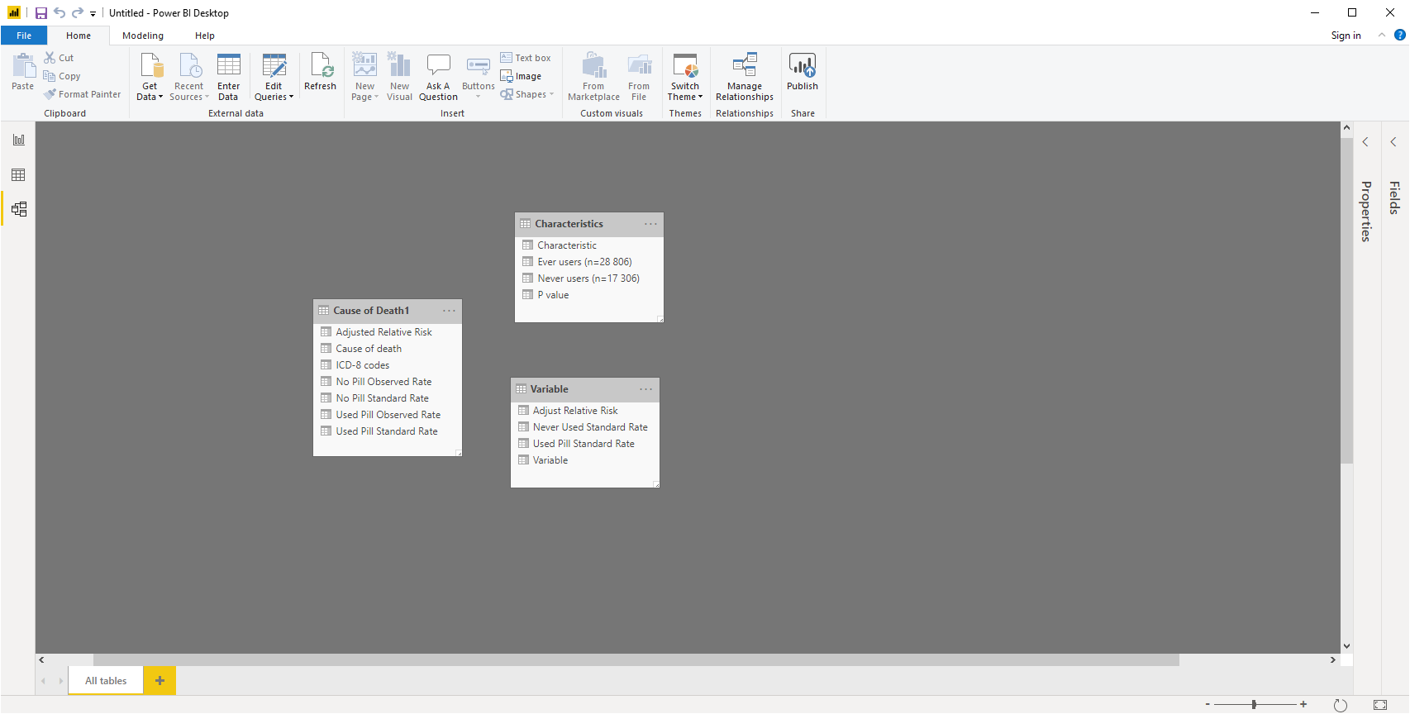
Datasets Relationship Model

Slide 7
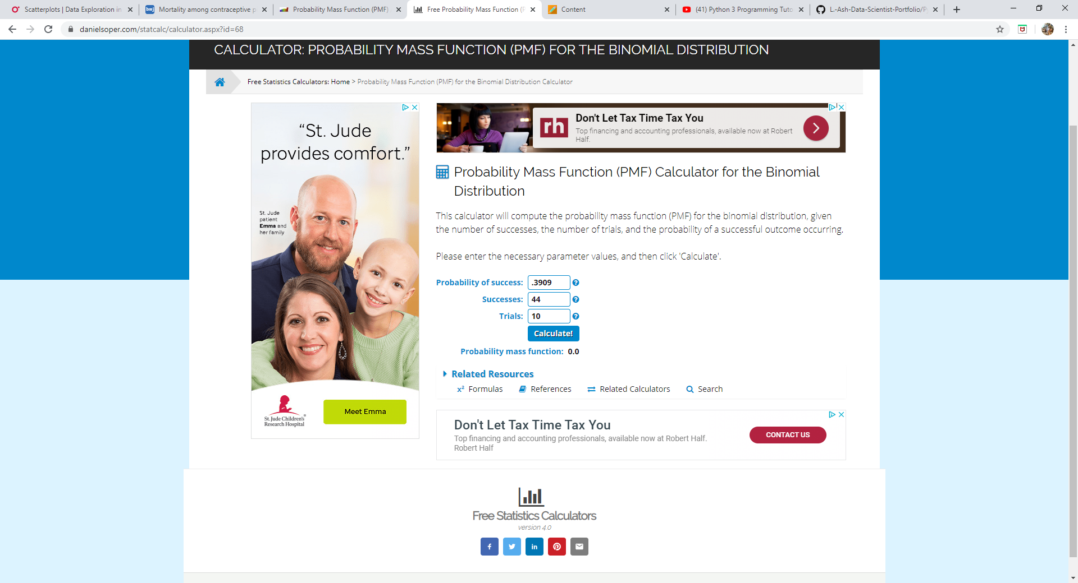
Probability Mass Function
I used the PMF to calculate the subject whom used the pill and was not observed against the subject whom was not observed, and the results were zero from the calculator.

Slide 8
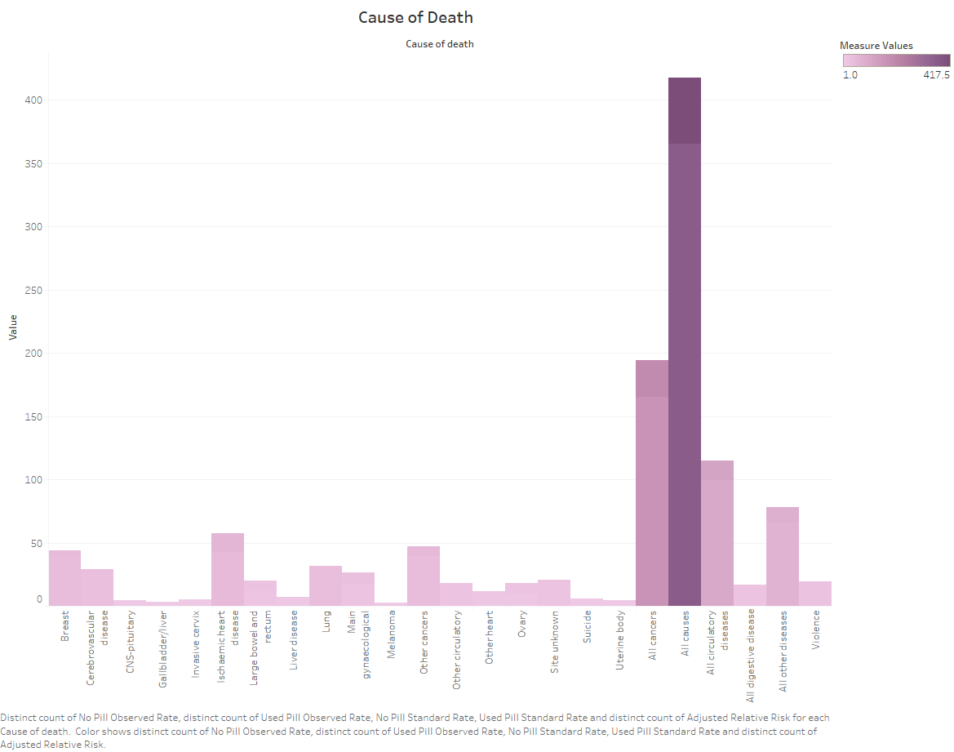
Causes of Death
The Cause of Death Histogram resulted in:
The top three causes of the death according to the histogram were any kinds of causes, cancers, and air circulatory issues.
The subjects may have contracted the cancer or other causes of death possibly before or during the study.
Women are still at risk of death for taking the pills. Women should find better alternatives to control birth.

Slide 9
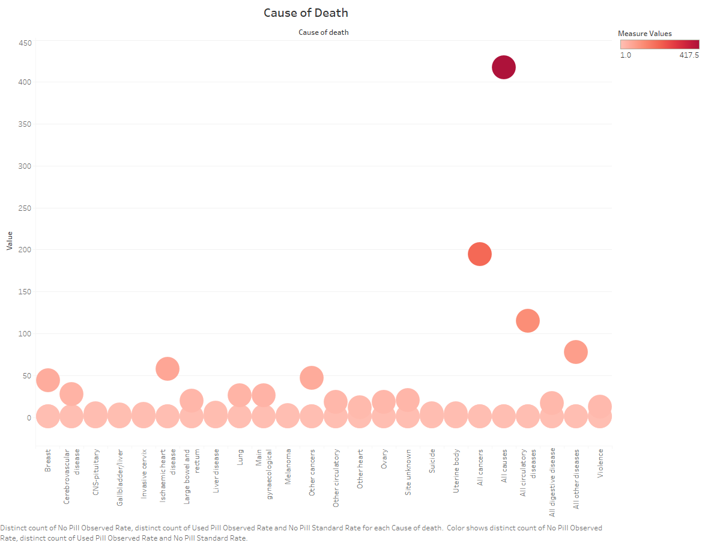
Scatter Plot 1
The scatter plot showed some outliers in the dataset.
The possible deaths were plotted on the x- axis and the measurements of the subjects whom used the pills are on the y-axis.

Slide 10
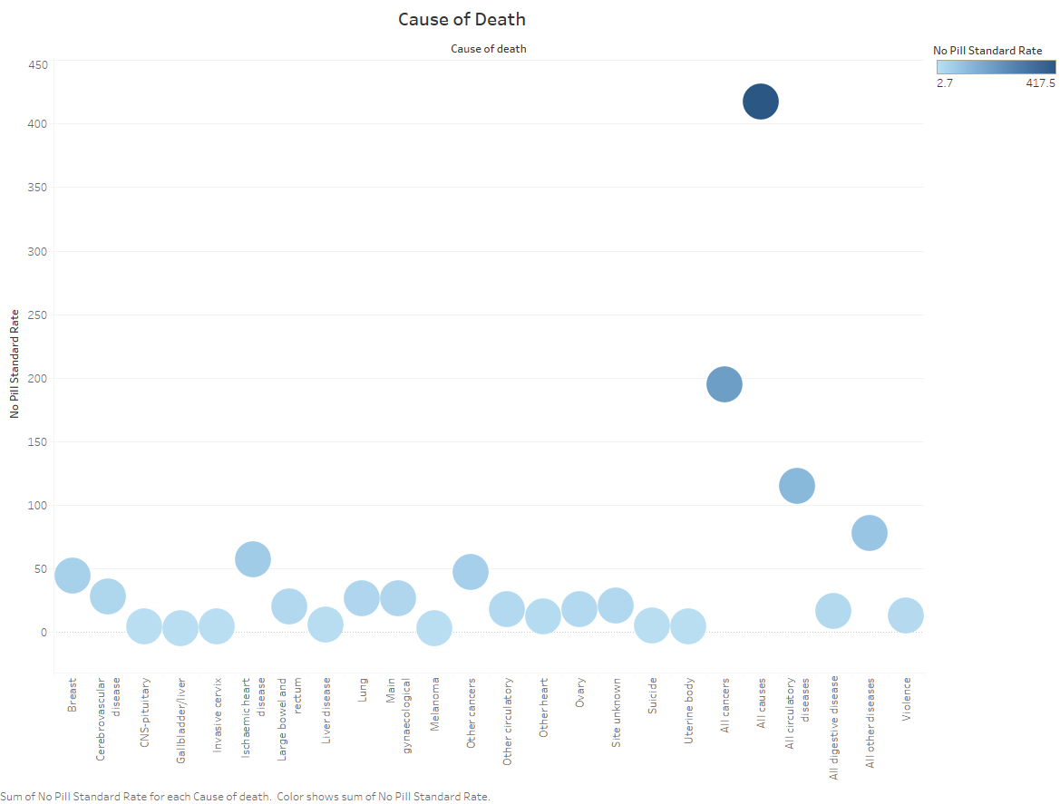
Scatter Plot 2
The scatter plot displayed the causes of death on the x- axis.
The y-axis contained the subjects that never used contraceptive pills.

Slide 11
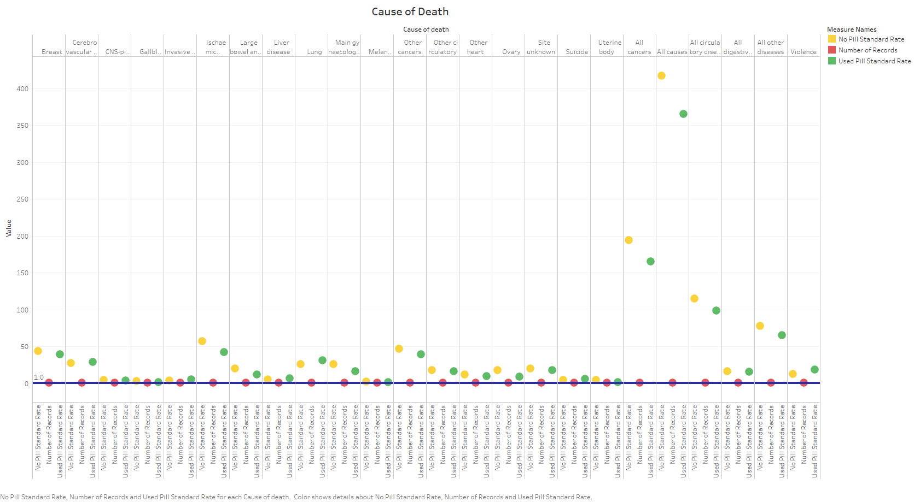
Scatterplot
Summary:
Count: 72
Sum: 2,230.0
Average: 31.0
Minimum: 1.0
Maximum: 417.5
Median: 5.8
Standard deviation: 71.0
First quartile: 1.0
Third quartile: 26.2
Skewness: 4.04
Excess Kurtosis: 17.21
I can handle outliers by deleting the problem that is causing the outlier.

Slide 12

Any Questions?

